Slide 1
Certificates & transcripts
Han Htoo Aung

Slide 2
CONTENTS
Primary Education
High School Education
GED Certificate & Transcript
IELTS
No-academic achievements

Slide 3
Academic achievements
In this parts, I would like to provide you with some academic achievements I was awarded from primary education to high school education.

Slide 4
Primary educational achievements
In Myanmar, Grade 1 to 5 is considered primary education. Besides, B.E.P.S means Basic Education Primary School, which consists of five Grades. During these periods, I achieved outstanding student, scholarship student, and selected candidate in English Subject.
(It was about nine years ago from now, so that some of the documents are missing and some are destroyed.)

Slide 5
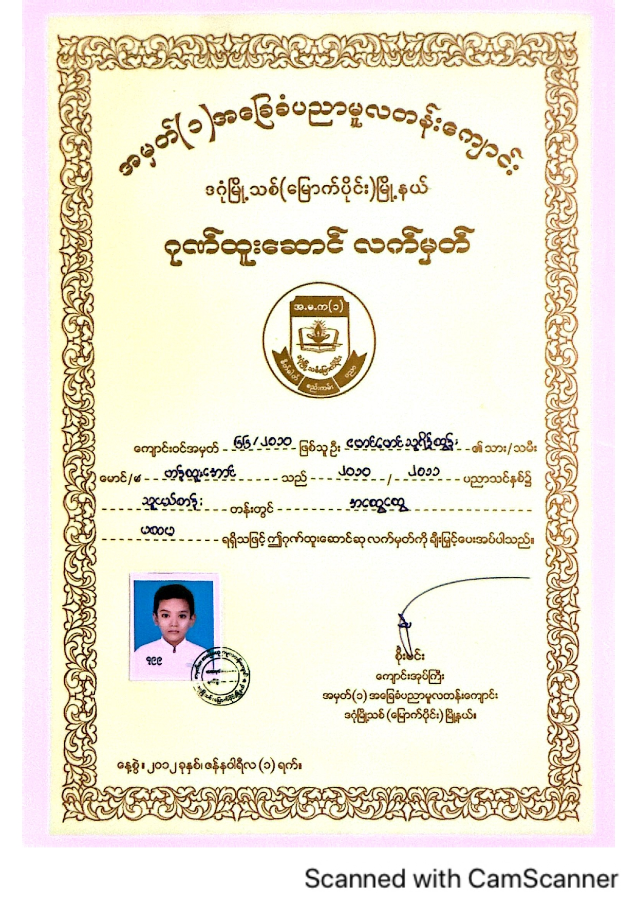
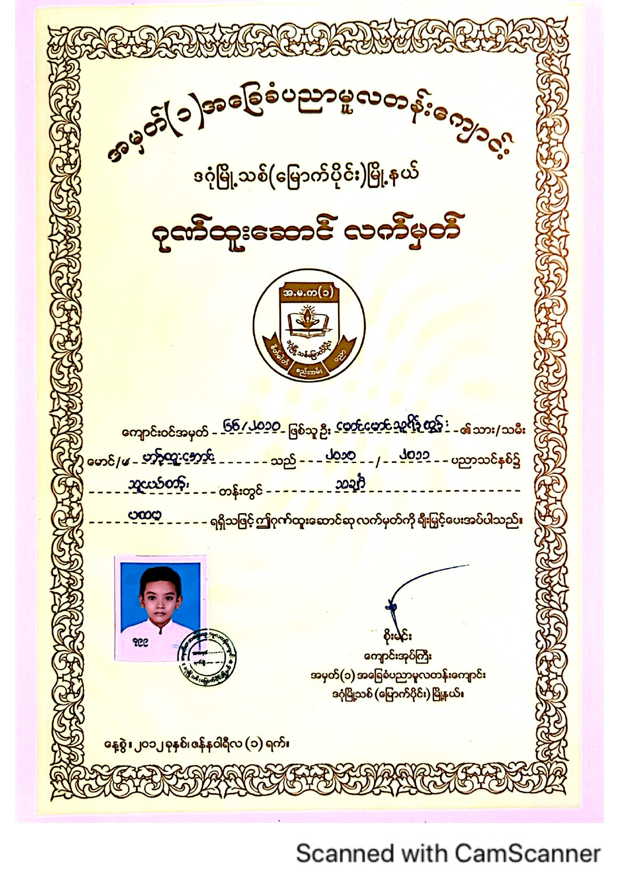
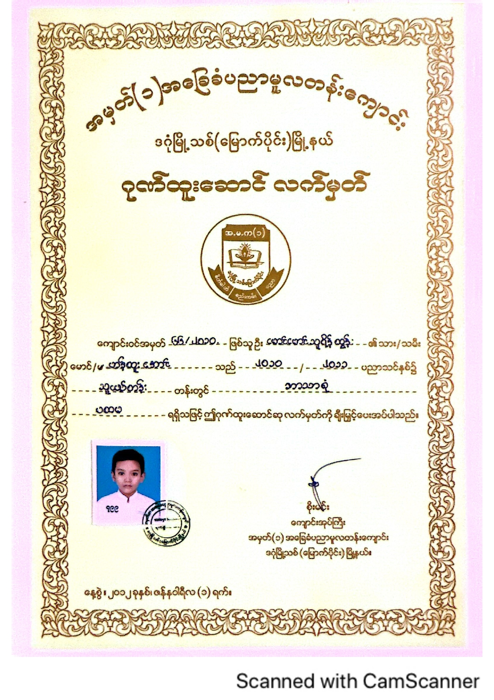
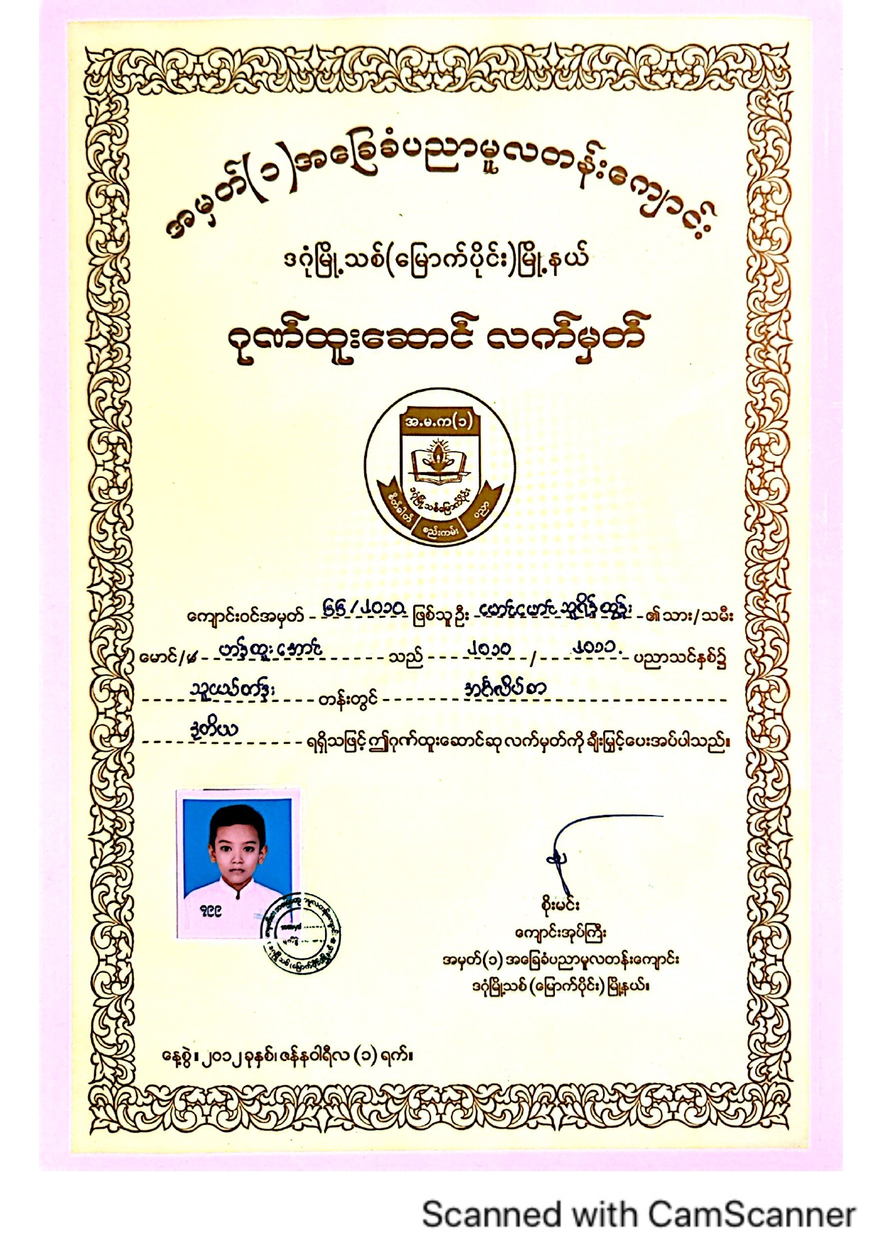
Primary Education Achievements
1st in Science (Grade-1)
1st in Math (Grade-1)
highest total marks (Grade-1)
2nd in English (Grade-1)

Slide 6
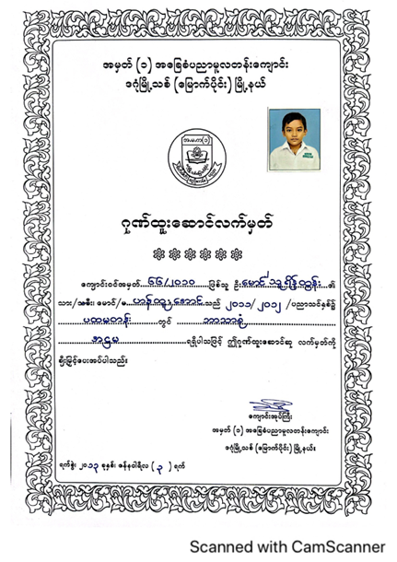
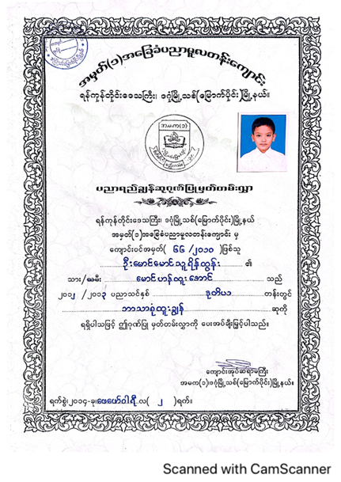
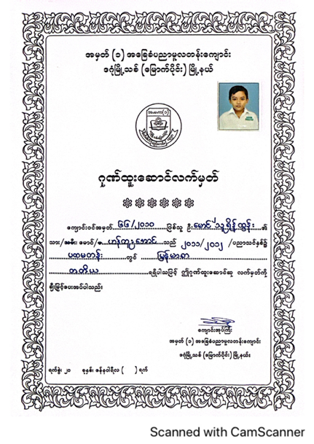
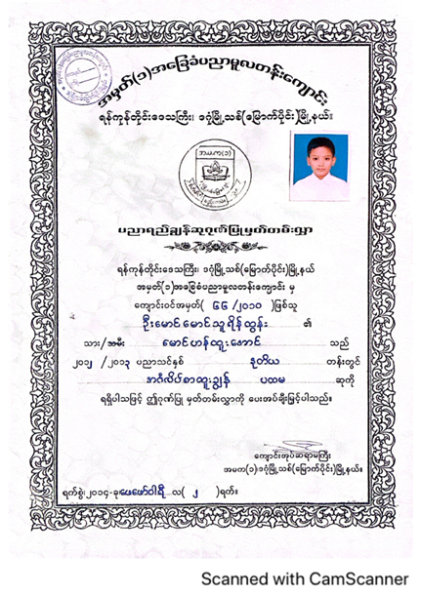
Primary Education Achievements
9th highest marks (Grade-2)
2nd highest marks (Grade-3)
3rd in Myanmar (Grade-2)
1st in English Competition (Grade-3)

Slide 7
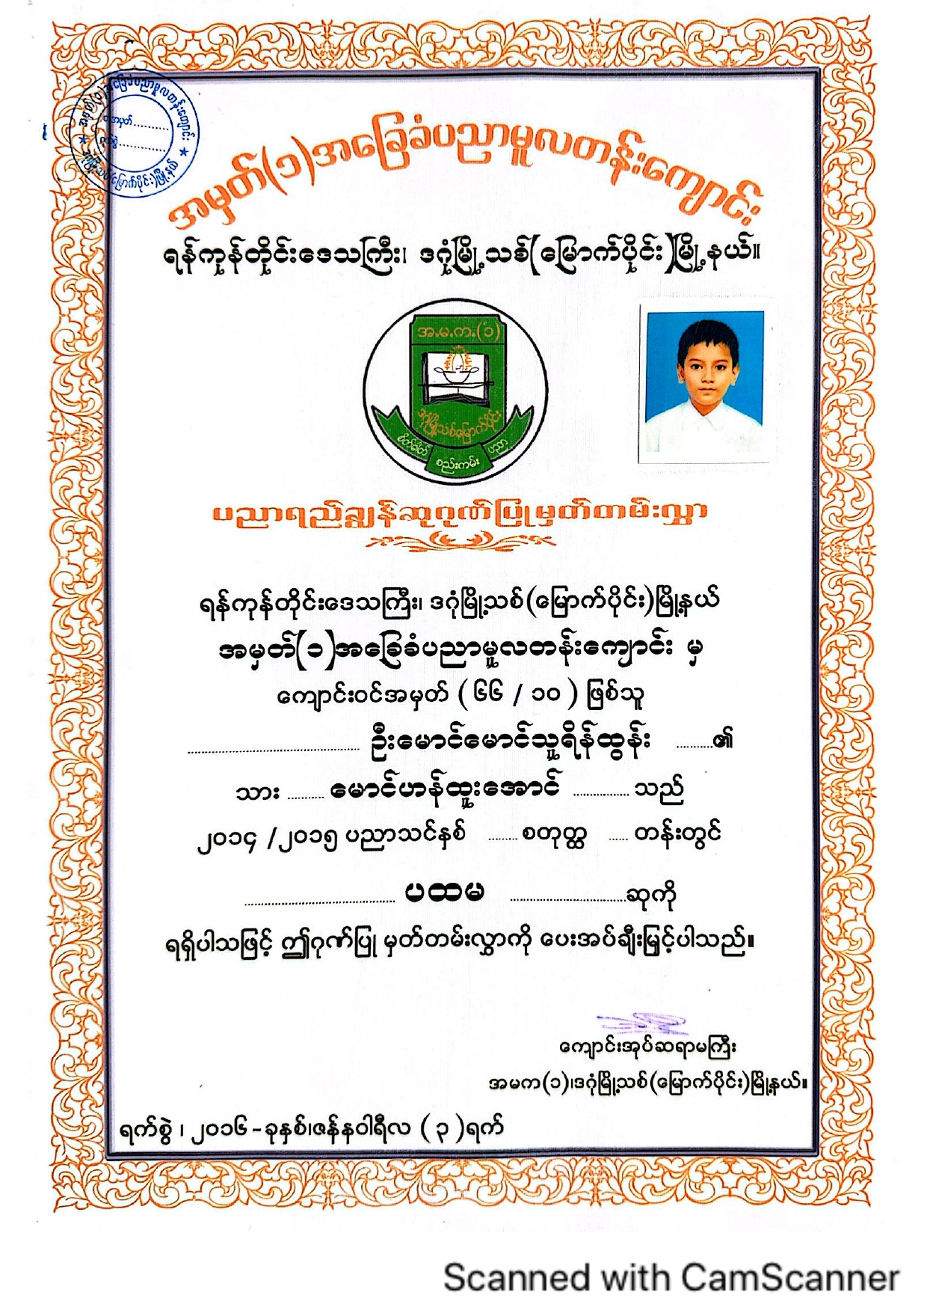
The scholarship chosen one
Three types of Government’s official examinations.
Highest total marks & Highest marks in individual subjects (Grade 5)
What a memorable moment for me and my parents either. I was chosen as a scholarship student unexpectedly for the first time in my life. I achieved both the highest marks and highest marks in individual subjects in school.
Besides, it was the first time for me and the school either. However, since I left B.E.P.S, I guess there will be students who are much smarter than me.

Slide 8
High school educational achievements
After Grade 5, I attended at B.E.H.S No.1, also known as Basic Education High School. (By the way, both primary and high schools locate in North Dagon Township, which is my lovely home town.) I studied from Grade 6 to 10 at B.E.H.S No.1. During these days, I mostly focused on sport and team works rather than academic.

Slide 9
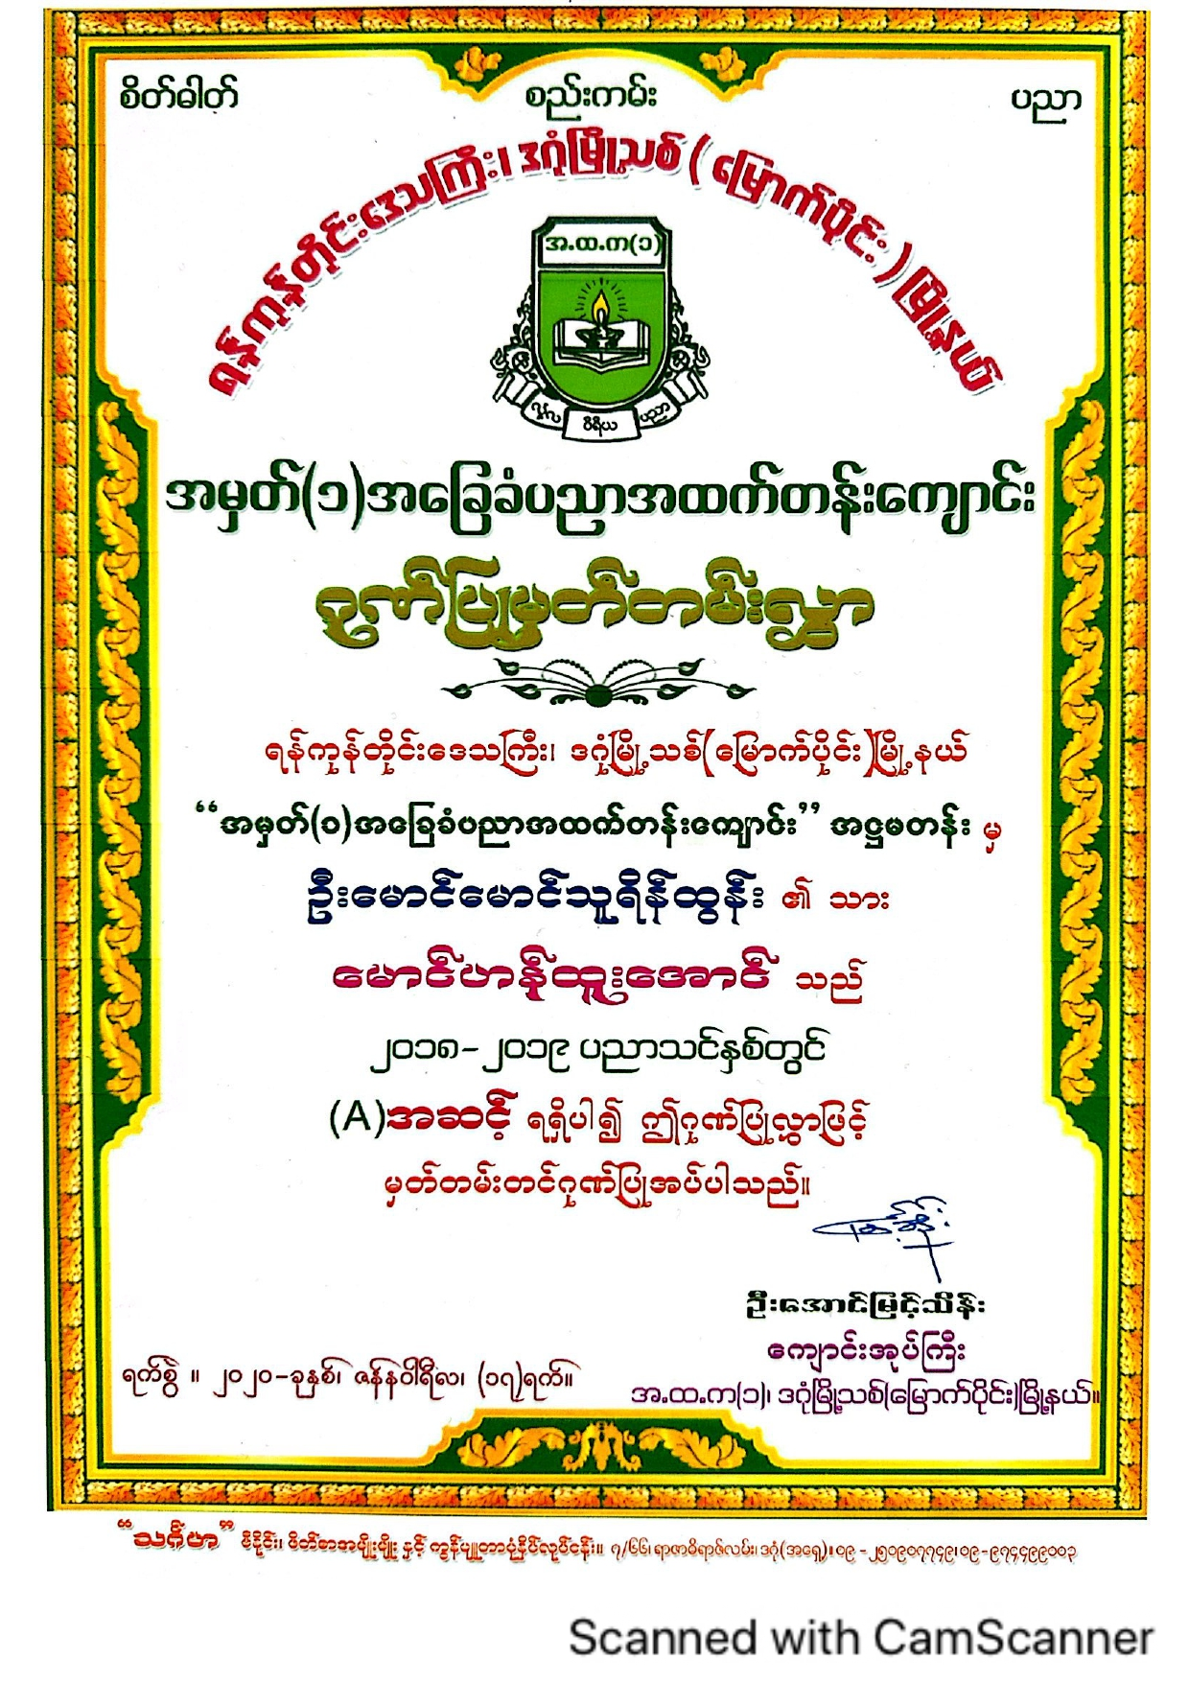
High School Educational achievements
Outstanding student in Grade 9
Three types of Government’s official examinations.
In Myanmar official education, there were three types of nationwide examinations along with eight examinations held by individual school.
During three nationwide exams, I achieved 1st in Grade 5, and outstanding student award in Grade 9 (which is shown grading A besides this paragraph.
However, due to some political instabilities and Coronavirus pandemic, I chose to drop out Grade 11 examination, which is the highest examination for Basic Education System, and studied GED.

Slide 10
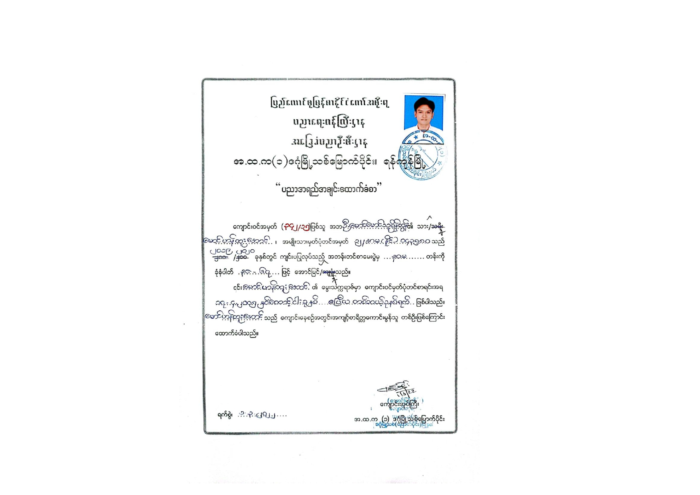
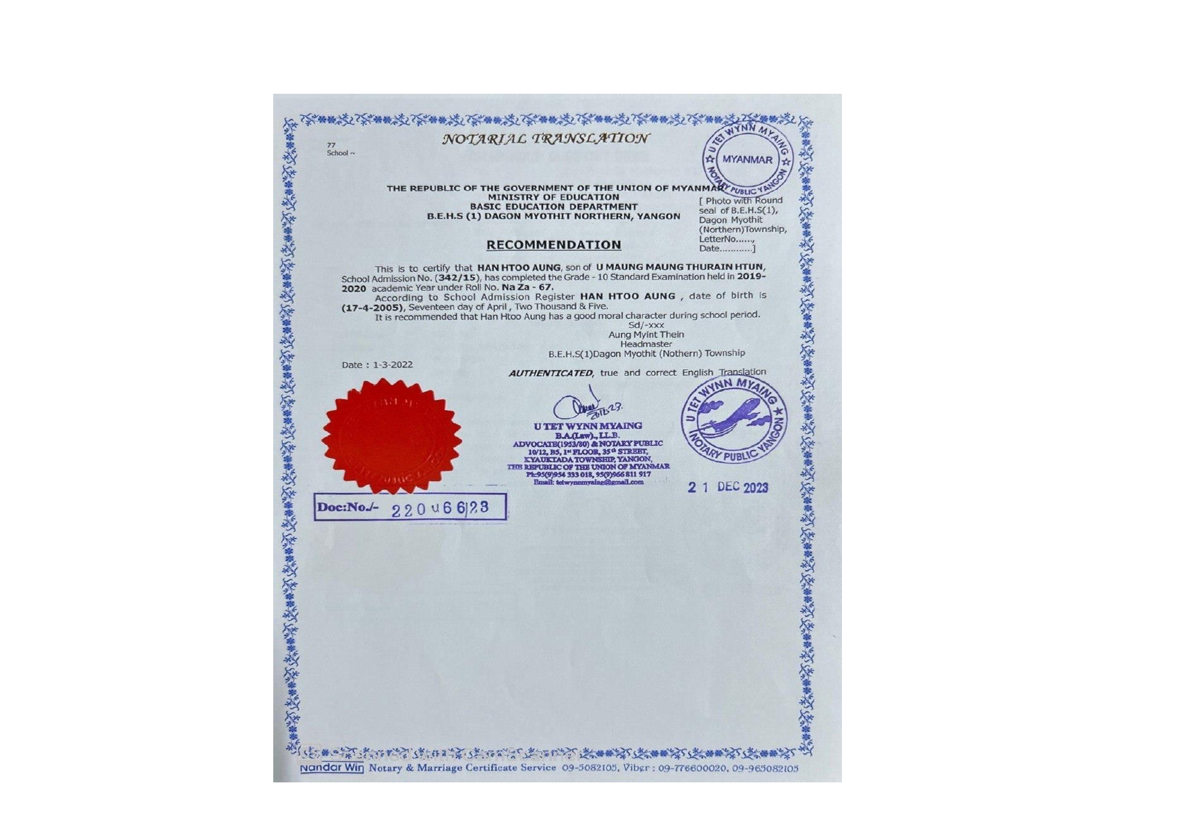
High school recommendation letter in Burmese &translated

Slide 11
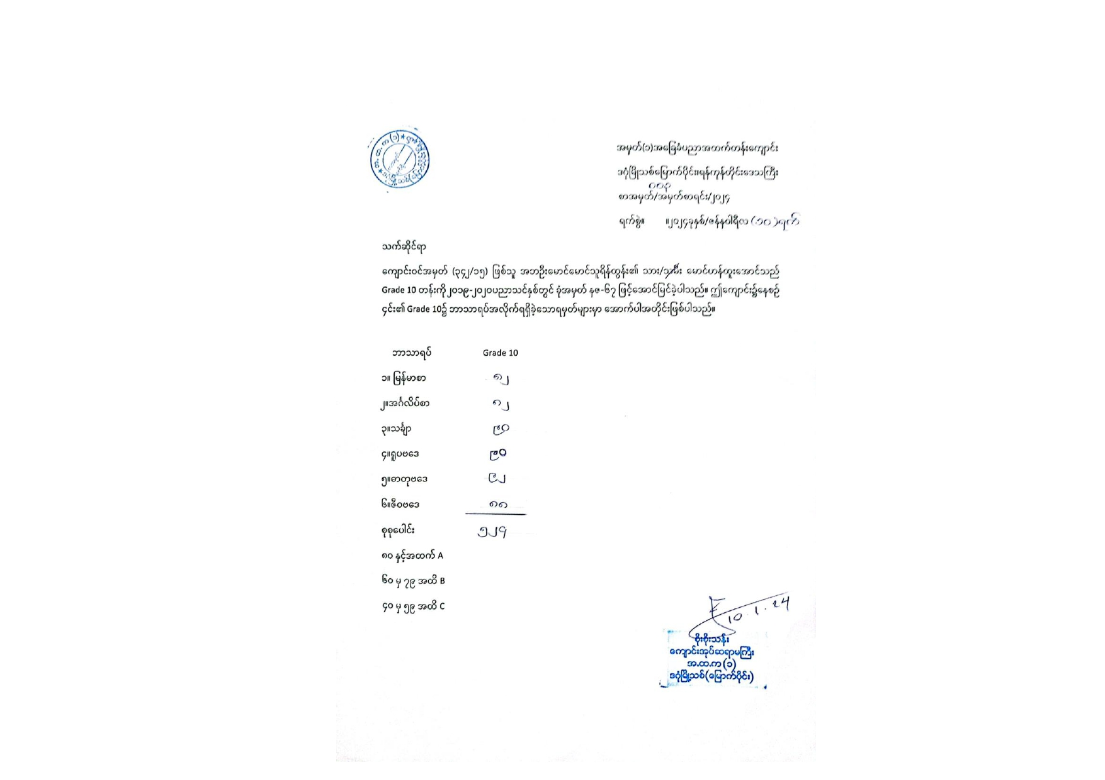
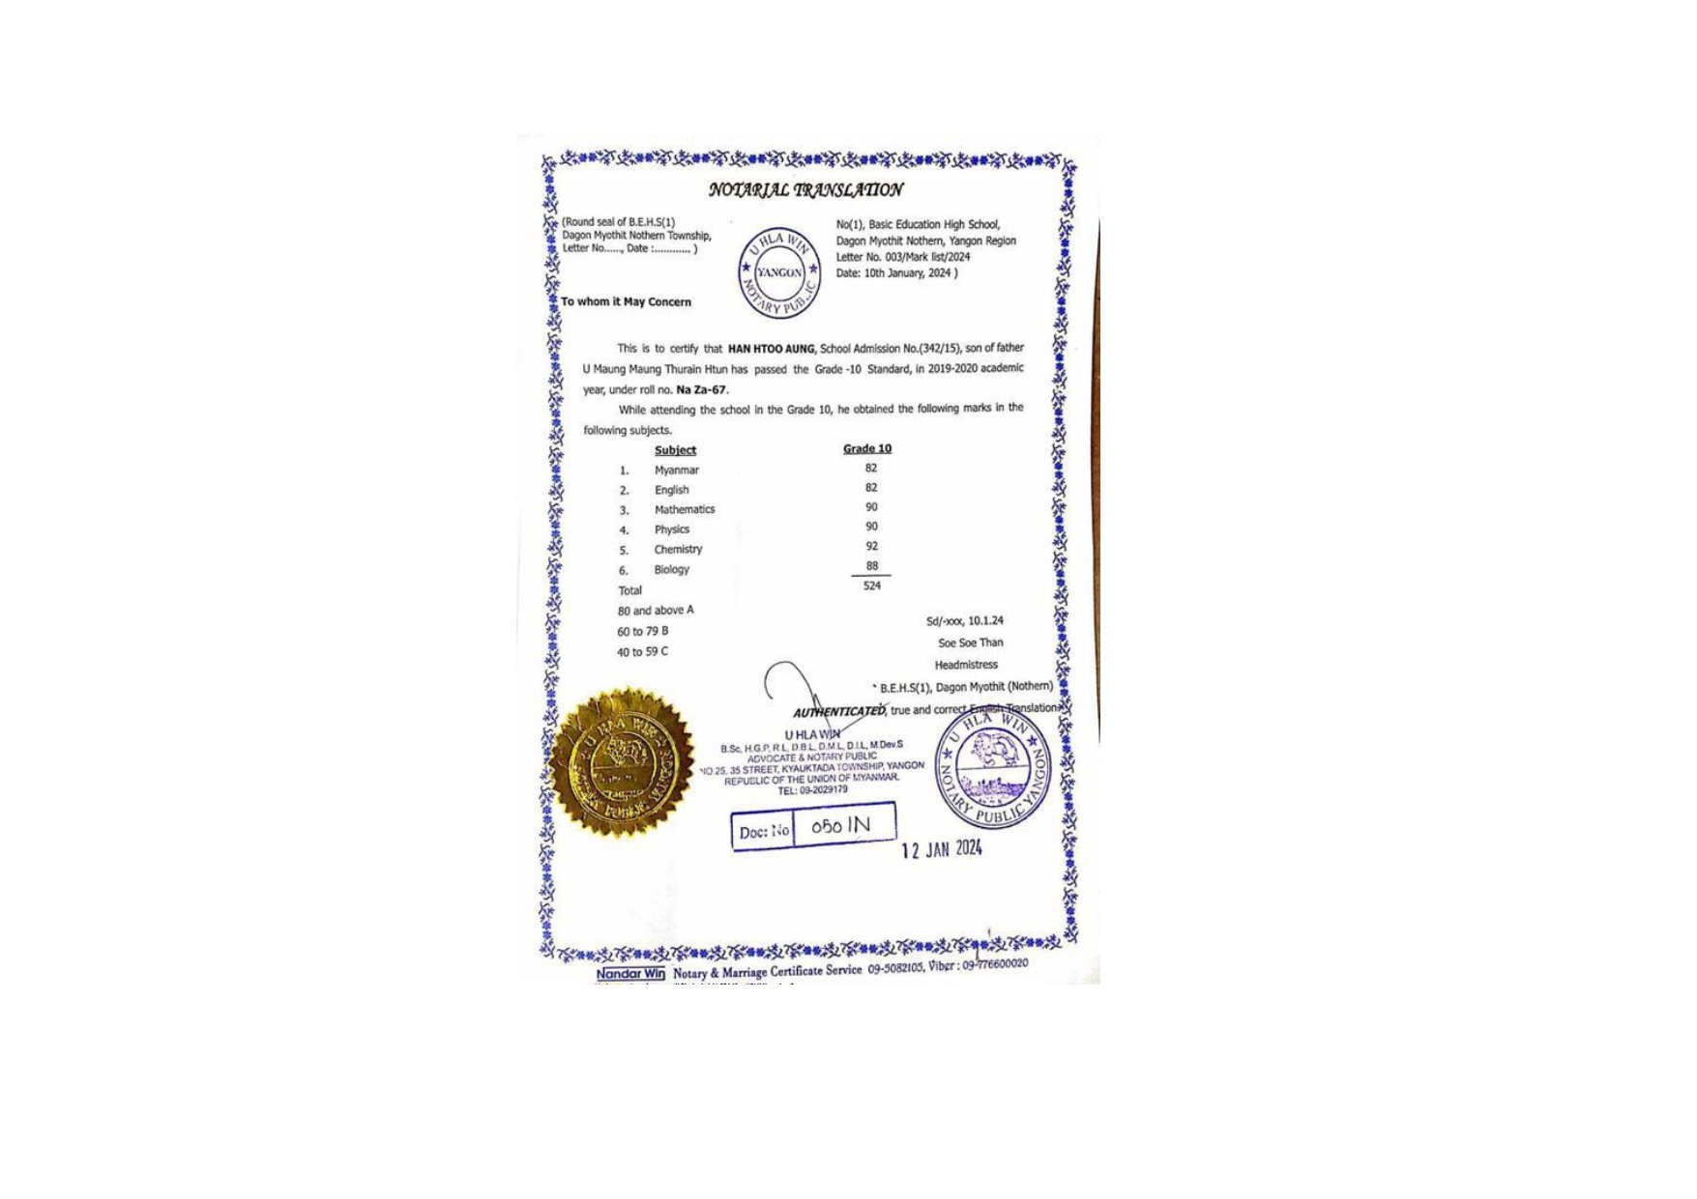
Total mark (grade-10) in Burmese &translated

Slide 12
International education Journey
Since I was a traditional student, I lack sufficient knowledge about International Education. Therefore, it was hard to choose whether I should study IGCSE or GED. However, I went for GED, which seemed much flexible and affordable for my family. Although it was challenging for me to begin an international education journey, I assume that managed to overcome. Besides, since English proficiency test is required for university admission, I also studied IELTS.

Slide 13
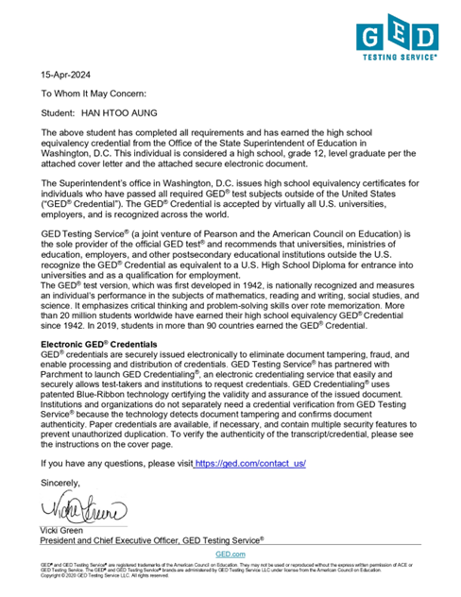
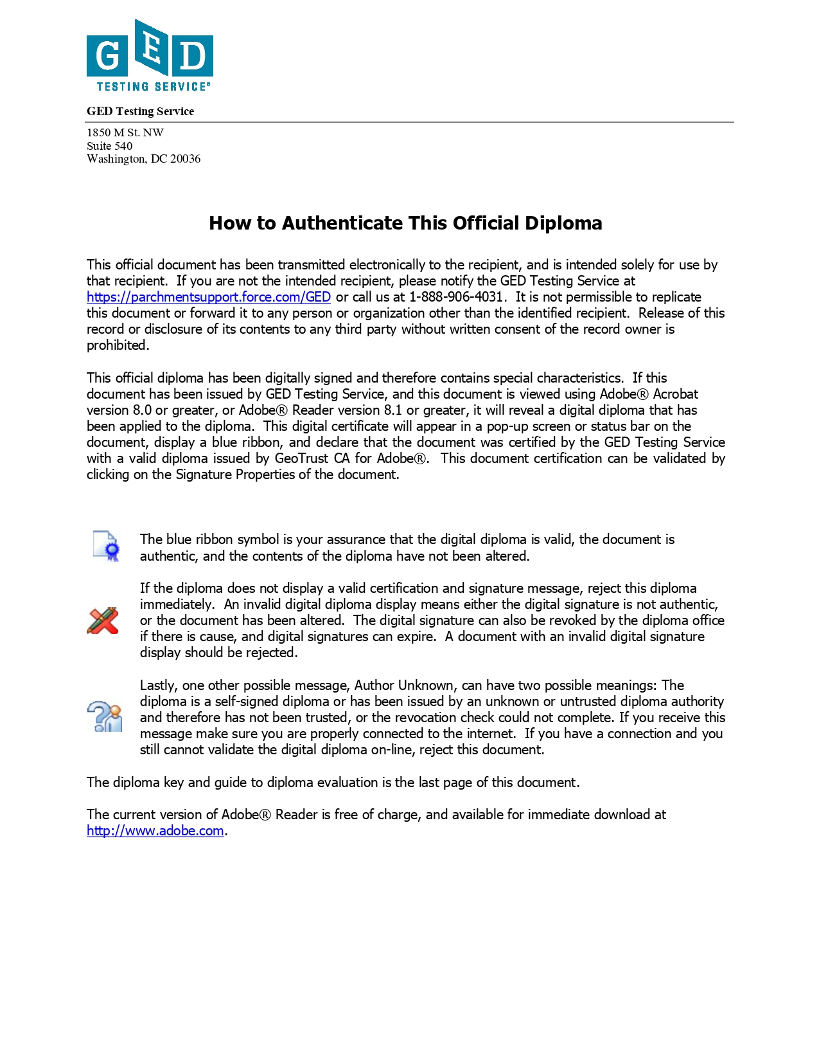
GED Verification Letters
Please do not mind that since both verification letters from certificate & transcript are the same, I will not repeatedly submit.

Slide 14
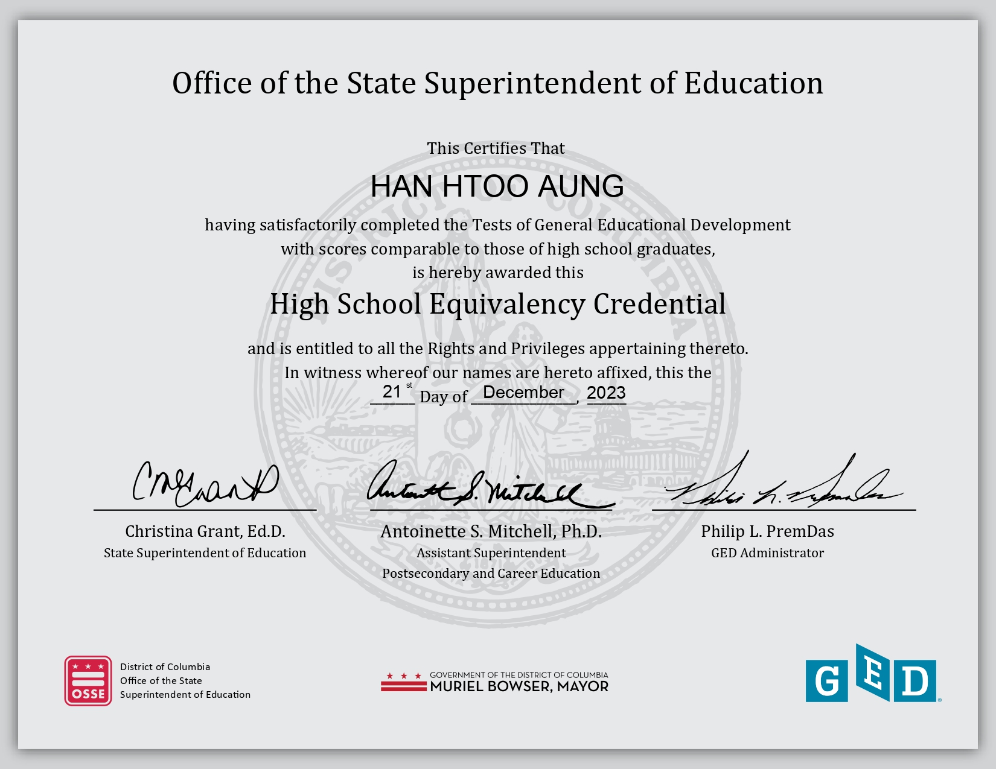
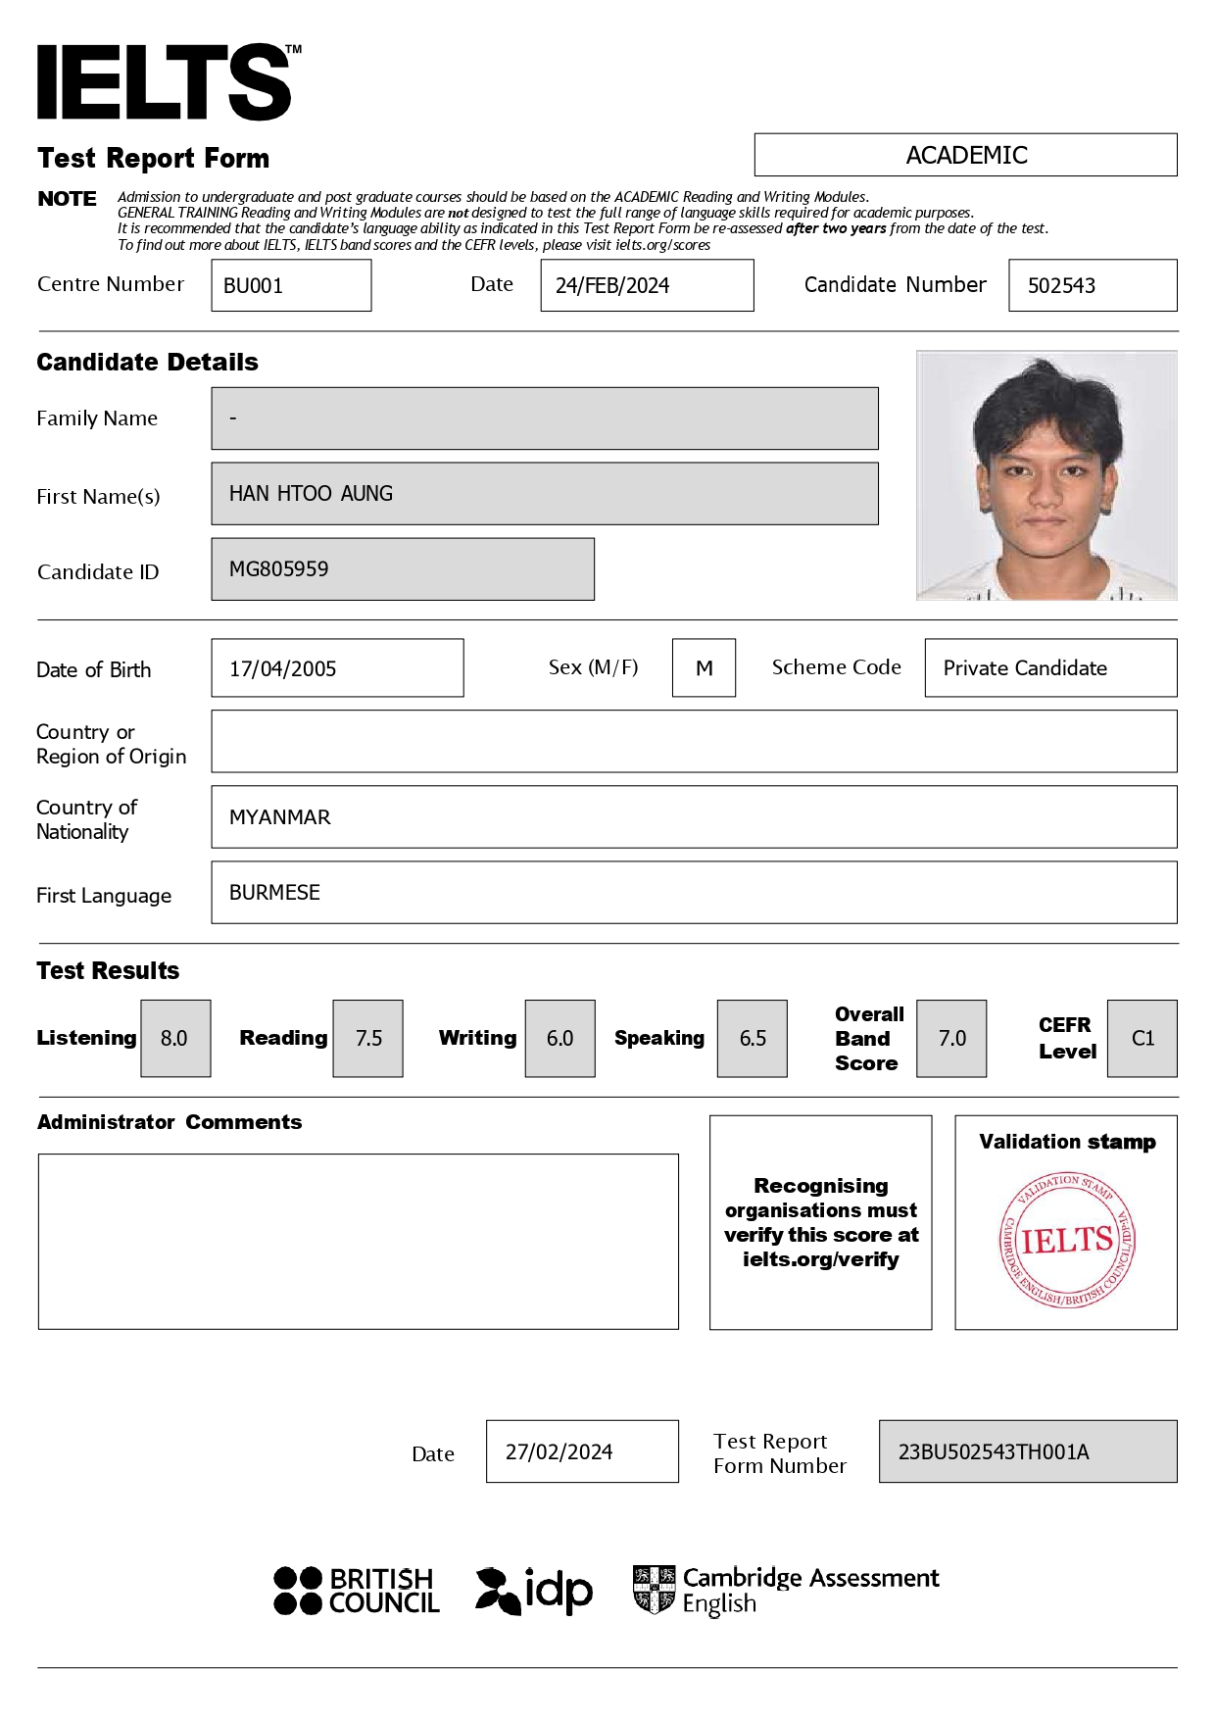
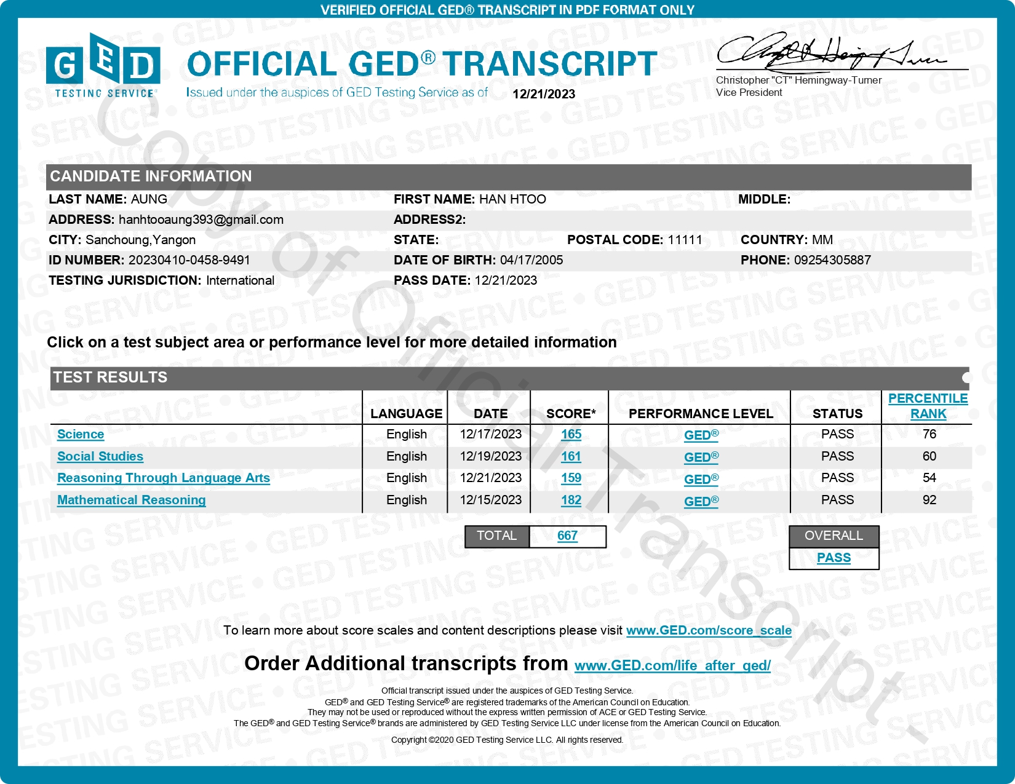
Ged
Certificate
Transcripts
IELTS official certificate

Slide 15
Additional documents
Vocational Certificate (Dual Tech)
Summer Basic Sport Class (Ministry of Sport and Youth Affair)

Slide 16
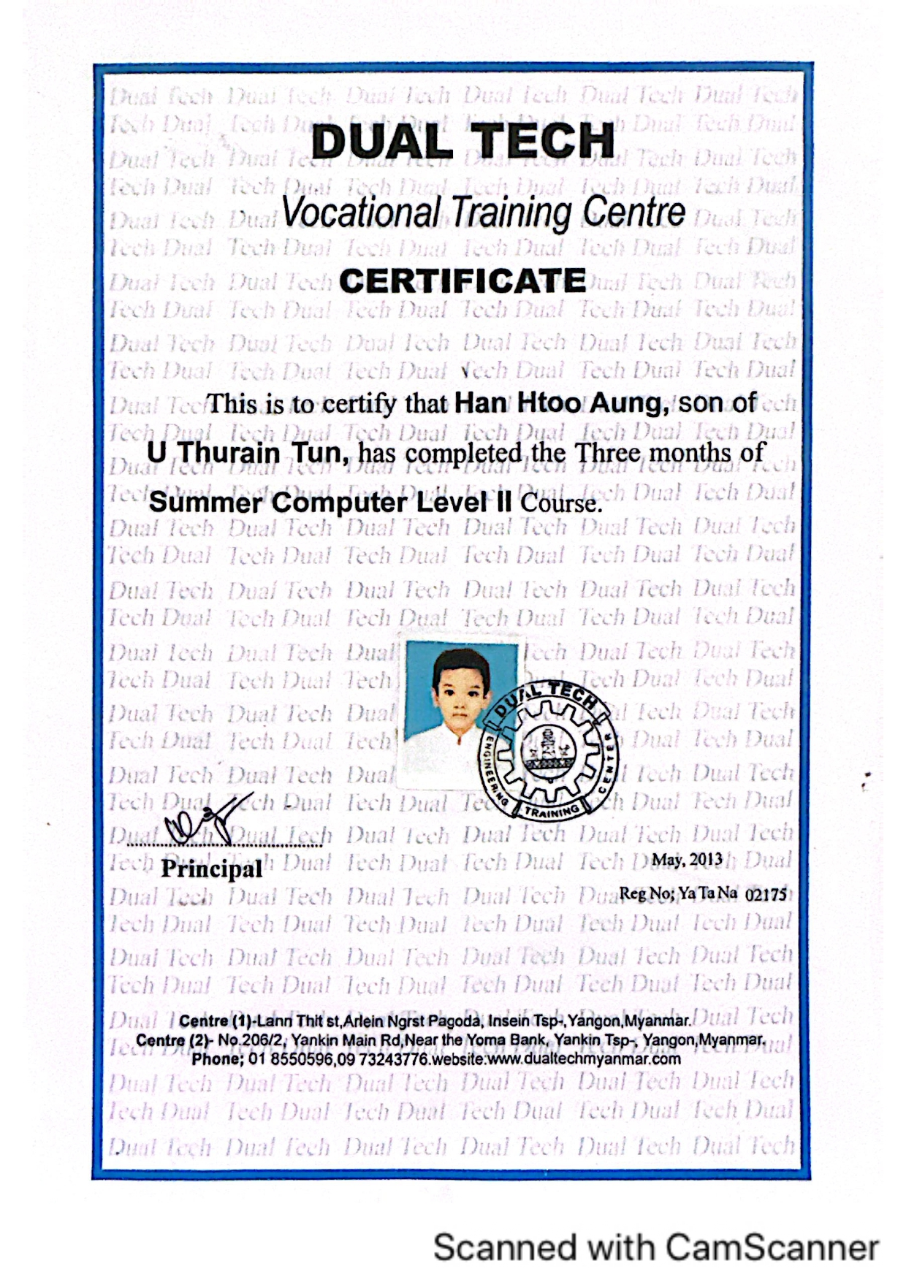
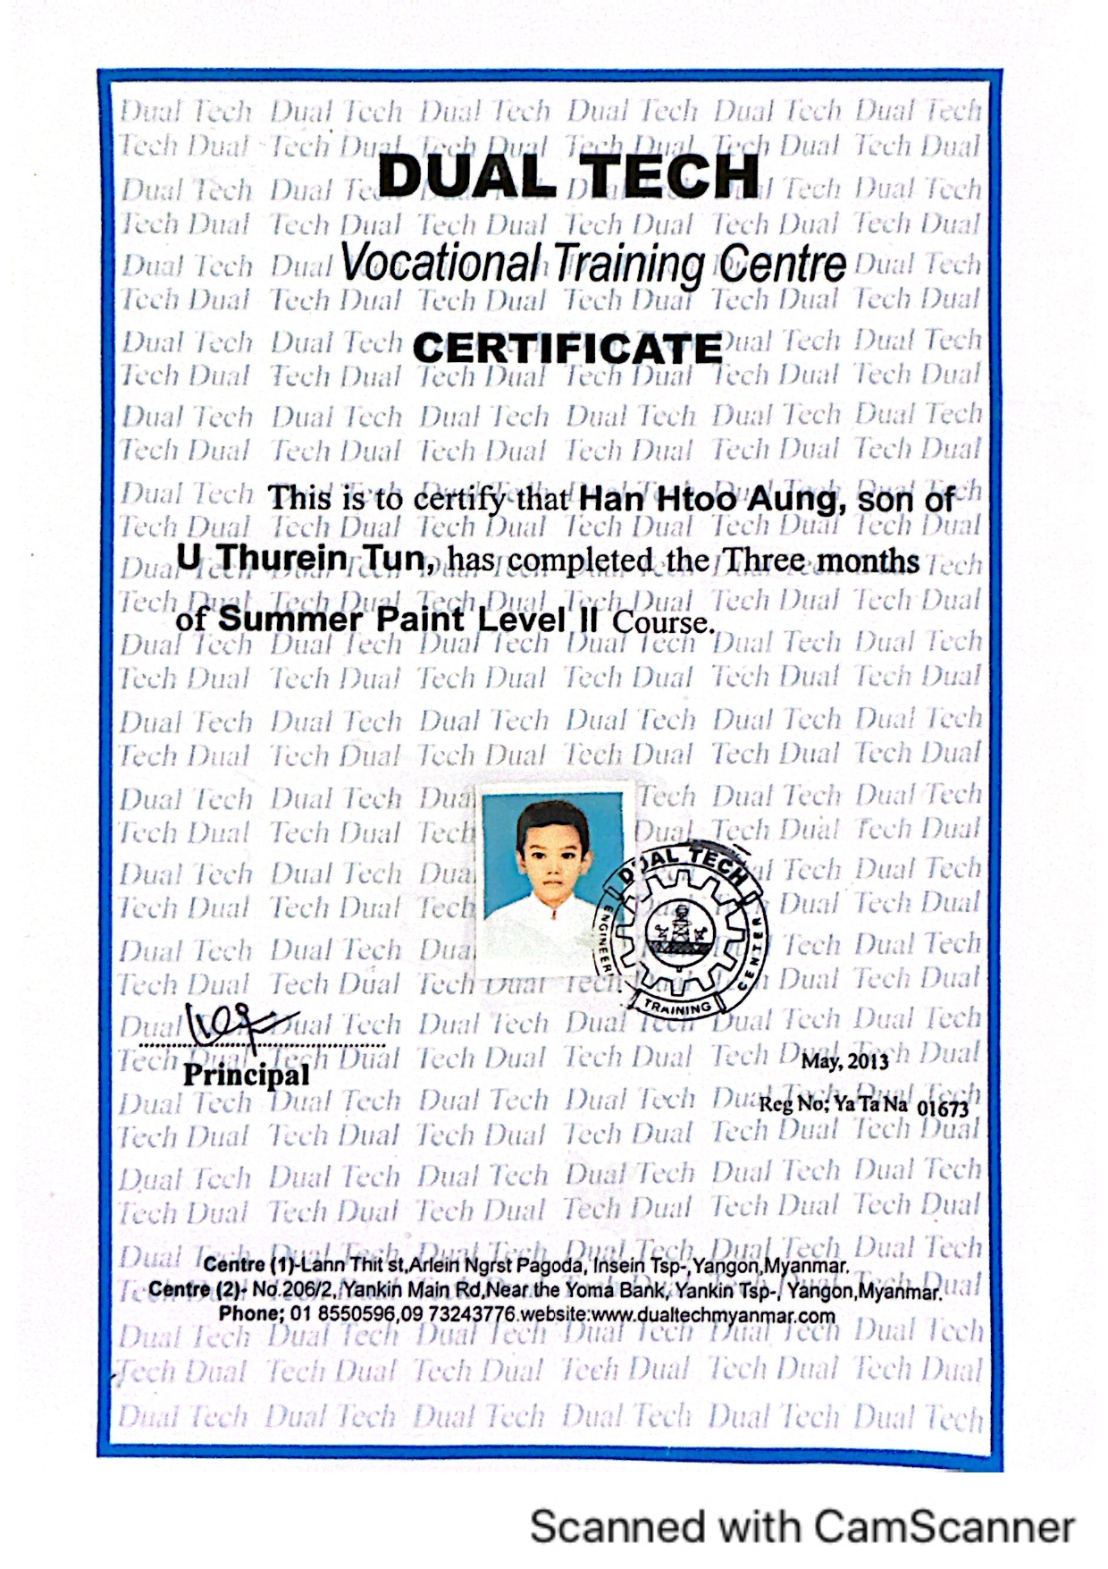
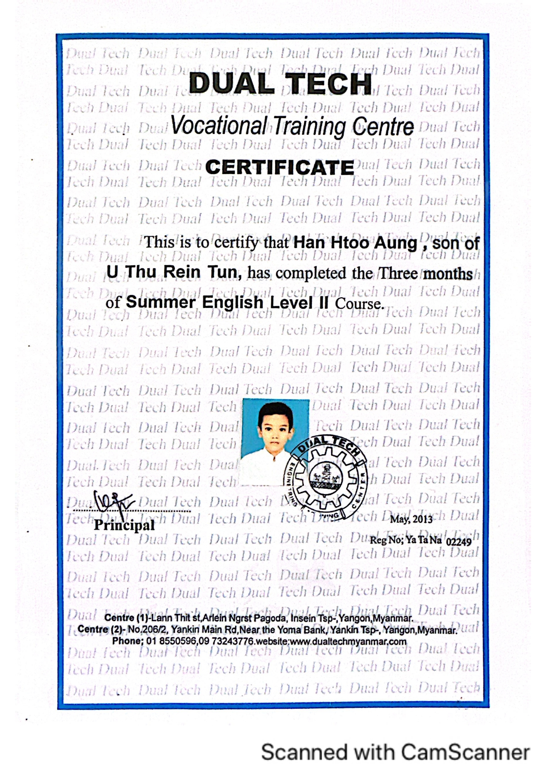
Vocational certificate (dual Tech)
Please do not mind that since both verification letters from certificate & transcript are the same, I will not repeatedly submit.

Slide 17
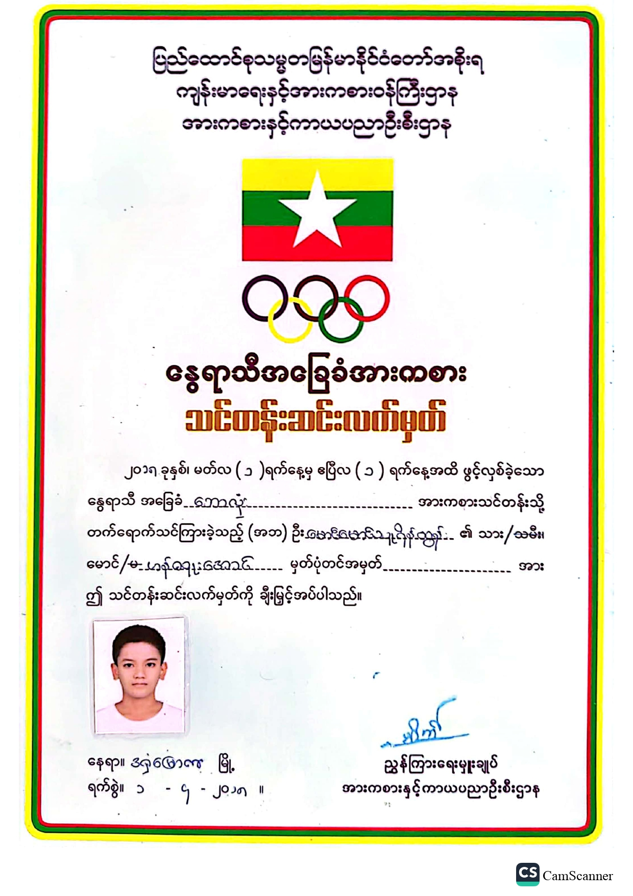
Summer Basic Sport Class (Ministry of Sport and Youth Affair)
Certificate of Youth Sport (Football)

